Slide 1
Building Multichannel Conversational Interfaces Using Amazon Lex and Automate deployment

Slide 2
Name: Patel Jainam ID: 20IT096 Name: Patel Shiv ID: 20IT113 Course: Software Group Project
Project Mentor: Jalpesh vasa
Batch: 7it2-A2

Slide 3
Introduction of project
Our aim is to develop a chatbot for our KDPIT website and integrate to our website(third party website)
Basically we will create this project using aws services like amazon lex further we can route our query dynamically through aws lambda(serverless services) and we can use aws dynamo DB and api gateway with aws lambda
We will create dynamic user interface and connect this our chatbot with UI so we can connect this UI with KDPIT website
We can build this with the help of NLP and conversational AI for bettwe performance
Amazon Lex is an AWS service for building conversational interfaces for applications using voice and text. With Amazon Lex, the same conversational engine that powers Amazon Alexa is now available to any developer, enabling you to build sophisticated, natural language chatbots into your new and existing applications. Amazon Lex provides the deep functionality and flexibility of natural language understanding (NLU) and automatic speech recognition (ASR) so you can build highly engaging user experiences with lifelike, conversational interactions, and create new categories of products.

Slide 4
What is Amazon LEX?
Amazon Lex is an AWS service for building conversational interfaces for applications using voice and text. With Amazon Lex, the same conversational engine that powers Amazon Alexa is now available to any developer, enabling you to build sophisticated, natural language chatbots into your new and existing applications. Amazon Lex provides the deep functionality and flexibility of natural language understanding (NLU) and automatic speech recognition (ASR) so you can build highly engaging user experiences with lifelike, conversational interactions, and create new categories of products.
Amazon Lex is an AWS service for building conversational interfaces for applications using voice and text. With Amazon Lex, the same conversational engine that powers Amazon Alexa is now available to any developer, enabling you to build sophisticated, natural language chatbots into your new and existing applications. Amazon Lex provides the deep functionality and flexibility of natural language understanding (NLU) and automatic speech recognition (ASR) so you can build highly engaging user experiences with lifelike, conversational interactions, and create new categories of products.

Slide 5
What is Amazon LEX? (continue…)
Amazon Lex enables any developer to build conversational chatbots quickly. With Amazon Lex, no deep learning expertise is necessary—to create a bot, you just specify the basic conversation flow in the Amazon Lex console. Amazon Lex manages the dialogue and dynamically adjusts the responses in the conversation. Using the console, you can build, test, and publish your text or voice chatbot. You can then add the conversational interfaces to bots on mobile devices, web applications, and chat platforms (for example, Facebook Messenger).
Amazon Lex is an AWS service for building conversational interfaces for applications using voice and text. With Amazon Lex, the same conversational engine that powers Amazon Alexa is now available to any developer, enabling you to build sophisticated, natural language chatbots into your new and existing applications. Amazon Lex provides the deep functionality and flexibility of natural language understanding (NLU) and automatic speech recognition (ASR) so you can build highly engaging user experiences with lifelike, conversational interactions, and create new categories of products.

Slide 6
Benefits of Amazon LEX
Simplicity: Amazon Lex guides you through using the console to create your own chatbot in minutes. You supply just a few example phrases, and Amazon Lex builds a complete natural language model through which the bot can interact using voice and text to ask questions, get answers, and complete sophisticated tasks.
Democratized deep learning technologies: Powered by the same technology as Alexa, Amazon Lex provides ASR and NLU technologies to create a Speech Language Understanding (SLU) system. Through SLU, Amazon Lex takes natural language speech and text input, understands the intent behind the input, and fulfills the user intent by invoking the appropriate business function.
Amazon Lex is an AWS service for building conversational interfaces for applications using voice and text. With Amazon Lex, the same conversational engine that powers Amazon Alexa is now available to any developer, enabling you to build sophisticated, natural language chatbots into your new and existing applications. Amazon Lex provides the deep functionality and flexibility of natural language understanding (NLU) and automatic speech recognition (ASR) so you can build highly engaging user experiences with lifelike, conversational interactions, and create new categories of products.

Slide 7
Benefits of Amazon LEX (continue…)
Seamless deployment and scaling: With Amazon Lex, you can build, test, and deploy your chatbots directly from the Amazon Lex console. Amazon Lex enables you to easily publish your voice or text chatbots for use on mobile devices, web apps, and chat services (for example, Facebook Messenger). Amazon Lex scales automatically so you don’t need to worry about provisioning hardware and managing infrastructure to power your bot experience.
Cost-effectiveness: With Amazon Lex, there are no upfront costs or minimum fees. You are charged only for the text or speech requests that are made. The pay-as-you-go pricing and the low cost per request make the service a cost-effective way to build conversational interfaces. With the Amazon Lex free tier, you can easily try Amazon Lex without any initial investment.
Amazon Lex is an AWS service for building conversational interfaces for applications using voice and text. With Amazon Lex, the same conversational engine that powers Amazon Alexa is now available to any developer, enabling you to build sophisticated, natural language chatbots into your new and existing applications. Amazon Lex provides the deep functionality and flexibility of natural language understanding (NLU) and automatic speech recognition (ASR) so you can build highly engaging user experiences with lifelike, conversational interactions, and create new categories of products.

Slide 8
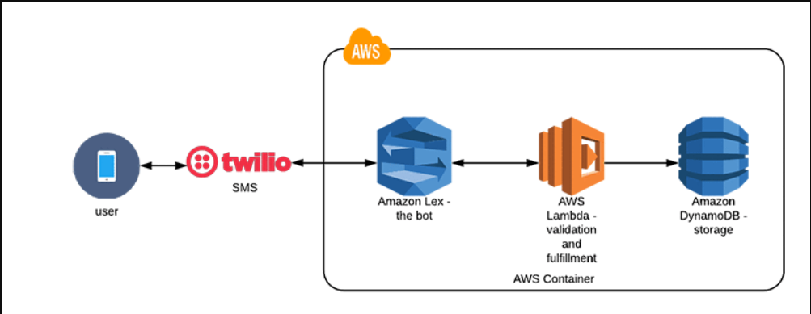
Project Architecture

Slide 9
Let’s say you want to get your bank account balance & you are using Amazon Lex Chatbot. Amazon Lex understands your request and performs necessary background tasks. It coordinates with Amazon Polly and asks you for further inputs in form of speech. Once it receives the information, it invokes AWS Lambda. Lambda retrieves the requested information or performs other types of actions. Like it might trigger Amazon SNS service to send you a notification or integrate with AWS CloudWatch to store logs & events.

Slide 10
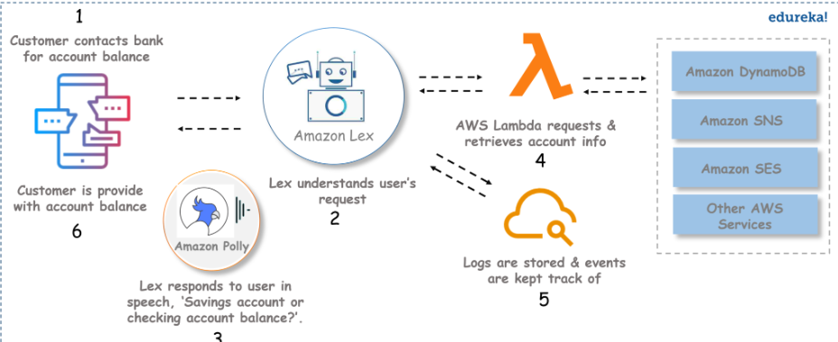

Slide 11
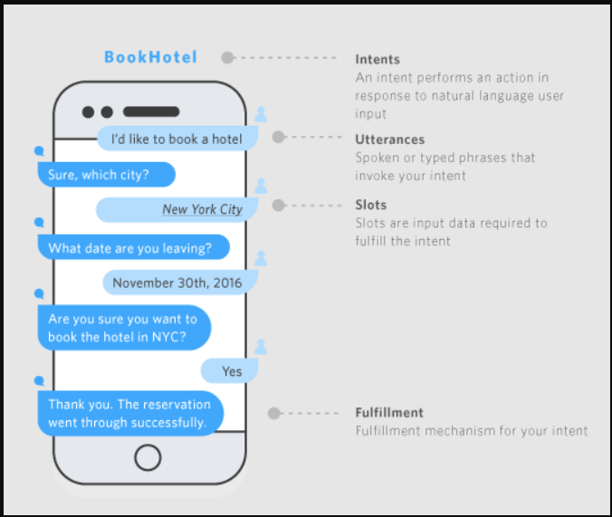

Slide 12
Thank You

